Slide 2
WELCOME
TO
IT’S YOUR MOVE

Slide 3
My Elementary School
My new Middle School
Looking ahead

Slide 4
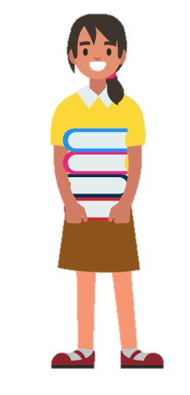
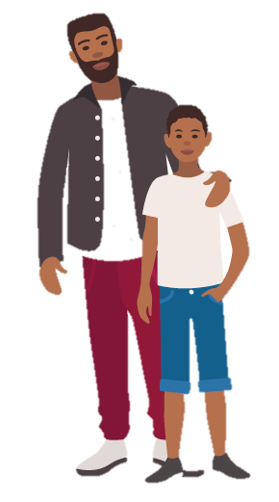
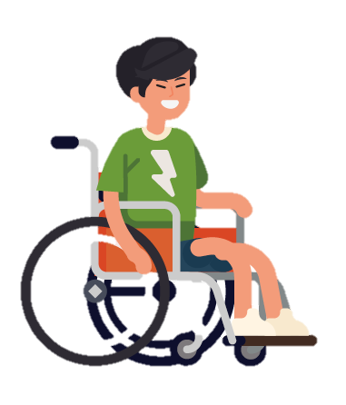
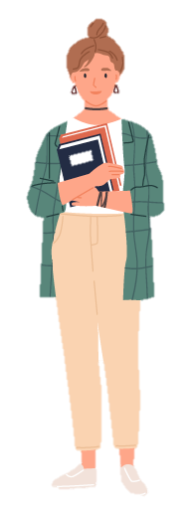
GET READY FOR A NEW START!
Meet
Joel
Meet
Miss Williams
Meet
Lydia
Meet Mr. Spahr and Asher
♫
Psalms, Proverbs, and words of Jesus

Slide 5
Get to Know Your New School
Be Prepared
You and Others
Make Good Choices
Be YOU!

Slide 6
GET TO KNOW YOUR NEW SCHOOL
40 School Principals
39 The school office
38 Teachers
37 Substitute teachers
36 Guidance counselors
All of the school staff members will know that you are new and be eager to help you. Older students probably will, too.
35 Bathrooms
34 The cafeteria
33 Rules
32 Website

Slide 7
GET TO KNOW YOUR NEW SCHOOL
David said about God: “I look behind me and you’re there, then up ahead and you’re there too – your reassuring presence, coming and going.
♫
It won’t take long
for you to feel at home in your new school; be a little patient – you’ll feel okay with everything in no time.
This is too much, too wonderful – I can’t take it all in!” Psalm 139:5&6
David said, “Depend on the Lord. Trust him, and he will take care of you.”
Psalm 37:5

Slide 8
GET TO KNOW YOUR NEW SCHOOL

Slide 9
BE PREPARED
31 Supplies
30 Books and eBooks
29 Lunch break
28 Getting to school
27 Tests and exams
26 Homework
25 School schedule
24 Finding your way
Get your backpack ready the night before so you won’t forget anything important.

Slide 10
BE PREPARED
You’ll probably forget some things and make a few mistakes along the way; everyone does. They’ll be fixed, and you’ll have learned new lessons!
“Careful planning puts you ahead in the long run; hurry and scurry puts you further behind.”
Proverbs 21:5
Jesus said, “God will help you deal with whatever hard things come up...”
Matthew 6:34b

Slide 11
BE PREPARED

Slide 12
HOW GOOD IS YOUR MEMORY?

Slide 13
YOU AND OTHERS
23 We’re all unique!
22 Friends
21 Don’t get angry
20 Criticism can be a good thing
19 Bullying
18 Laughter
17 Be grateful
16 Be kind to others
15 Parents and guardians
Relax – there are so many ways to make new friends in school.
“A friend loves at all times. They are there to help when trouble comes.” Proverbs 17:17

Slide 14
YOU AND OTHERS
Friends are important – try to be as good a friends as the ones you’re looking for.
Be ready to say “NO” to things that are bad for you. They’re just not worth it, no matter how you look at it!
Jesus said, “Here is a simple rule of thumb for behavior. Ask yourself what you want people to do for you; then grab the inititative and do it for them!” Luke 6:31

Slide 15
YOU AND OTHERS

Slide 16
MAKE GOOD CHOICES
14 Think before you act
13 Money
12 Social networks
11 Detention
10 Choices about friends
9 Be ready to learn
8 Clubs
Try new courses and clubs – you may just find new things you like and are good at.
“The fear of human opinion disables; trusting in God protects you from that.” Proverbs 29:25
Jesus said, “Those who want to do right more than anything else are happy.” Matthew 5:6

Slide 17
MAKE GOOD CHOICES

Slide 18
IT’S YOUR CHOICE

Slide 19
BE YOU!
7 Our bodies
6 Acne
5 Exercise and Fitness
4 Think before you act
3 Lonliness
2 Feeling awkward
1 Be YOU
Don’t be surprised when God takes care of those things you worried about.
Jesus said, “If God gives such attention to the appearance of wildflowers – most of which are never seen – don’t you think he’ll attend to you, take pride in you, do his best for you? Matthew 6:30

Slide 20
BE YOU!
♫
In spite of the worries I had about moving to middle school, it’s great to know that God will always be with me – just like he was in elementary school.
“Pile all you troubles on God’s shoulders – he’ll carry your load, he’ll help you out. Psalm 55:22

Slide 21
BE YOU!

Slide 22
READY OR NOT
Now that you have been through the 40 Top Tips, how ready are you for your new school?
READ THE QUESTIONS
AND CIRCLE THE ANSWER MOST LIKE YOU

Slide 23
READY OR NOT?
IF YOU GOT:
What’s your score?
Find out how many points your answers are worth, add them up and see!
0-11 points: Hmmm…you could do with thinking about things a bit more before starting school. Talk to a parent, teacher, or someone you trust.
12-21 points: You’re getting there but there’s a way to go yet before you make the move. Make sure you read all of this guide to get some tips.:
(1) a=5 b=2 c=1 d=8 (2) a=2 b=1 c=8 d=1 (3) a=2 b=1 c=8 d=4
(4) a=4 b=2 c=8 d=1
(5) a=5 b=2 c=2 d=8
22-31 points: You’re almost ready! Keep reading this guide and ask an adult any questions you have.
32-40 points: WELL DONE! Clearly, you’ve been preparing and you’re ready to go!

Slide 24
YOUR NAVIGATION GUIDES
Although I will miss everyone from elementary school, I have made lots of new friends and really like the teachers in my new school. Getting around school in my wheelchair is no problem, and everyone helps me whenever I need it – I usually don’t even have to ask! I see that God is always with me, just as he was in elementary school. Here is one of my favorite verses from the Bible that helped me.
Joel
“Trust God from the bottom of your heart; don’t try to figure out everything on your own.” Proverbs 3:5

Slide 25
YOUR NAVIGATION GUIDES
I think it’s fun to ride the bus to school! I will miss my elementary school, but I have lots of new friends, love my different classes, and I joined a girl’s hockey team. And middle school is helping me learn to be more independent and responsible – more grown up. Here is something that Jesus said that helped me.
Lydia
“If God gives such attention to the appearance of wildflowers – most of which are never seen – don’t you think he’ll take pride in you, do his best for you?” Matthew 6:30

Slide 26
YOUR NAVIGATION GUIDES
I love teaching middle schoolers! I am grateful that I have been able to help lots of new students, answering their questions, encouraging them to make new friends and to do their best with new subjects. I am glad to give advice and help my students succeed!
Miss Williams

Slide 27
YOUR NAVIGATION GUIDES
My son Asher and I found out that we didn’t need to worry. In answer to our prayers, God took perfect care of Asher. We are thankful that he has settled in and is doing very well. And it turns out that Asher enjoys what he is learning by doing his homework! This verse from Proverbs helped us a lot.
Mr. Spahr and Asher
“Put God in charge of your work, then what you’ve planned will take place,” Proverbs 16:3

Slide 28
MEET YOUR LOCAL GUIDES
(THIS IS THE PLACE TO PUT THE NAMES OF ANY SPECIAL TEACHER AND STUDENT GUESTS THAT YOU INTERVIEW)

Slide 29
WHAT’S ON YOUR MIND
Your feelings about moving up
People I can talk to about worries
Things I would like to talk about with God

Slide 30
Getting to School
Finding Your Way Around School
What to Wear
New Experiences
Make a Friend – Be a Friend
Stand Up Against Bullying
Cyberbullying
Keep Yourself Safe
Help Others

Slide 31
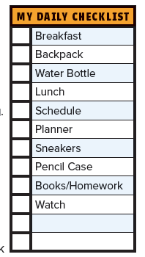
PUZZLES AND MORE

Slide 32
CLOSING COMMENTS
(THIS IS WHERE YOU CAN INCLUDE CLOSING COMMENTS AND INFORMATION ABOUT CHURCH ACTIVITIES AND MORE HELP.)

Slide 33
EXPECT GOOD THINGS TO HAPPEN
AFTER YOU HAVE BEEN AT MIDDLE SCHOOL A FEW WEEKS, WRITE DOWN YOUR THOUGHTS ON THE LAST PAGE OF THE BOOKLET.

